Slide 1
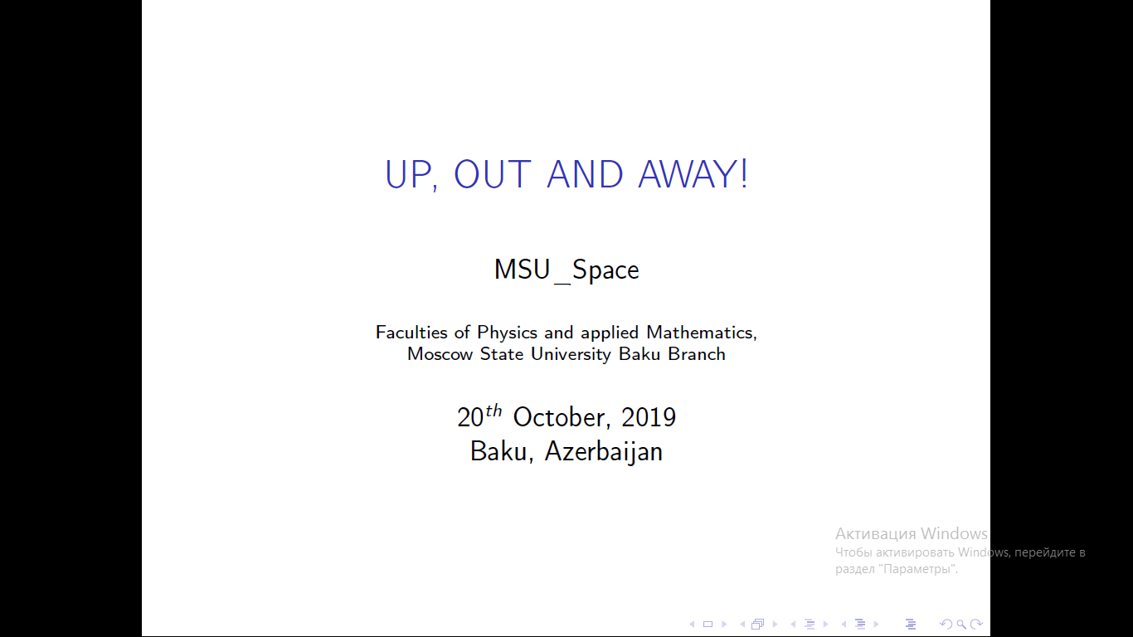

Slide 2
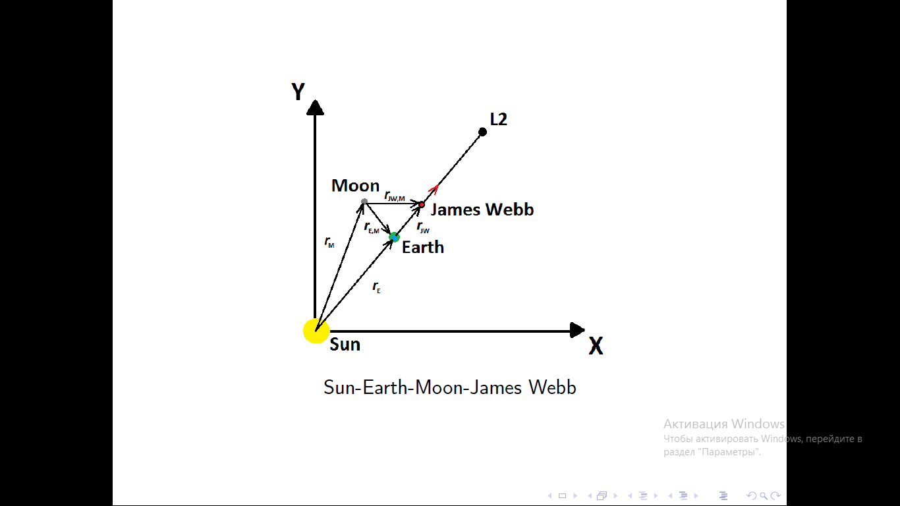
!
Everything was created without physics engine!

Slide 3
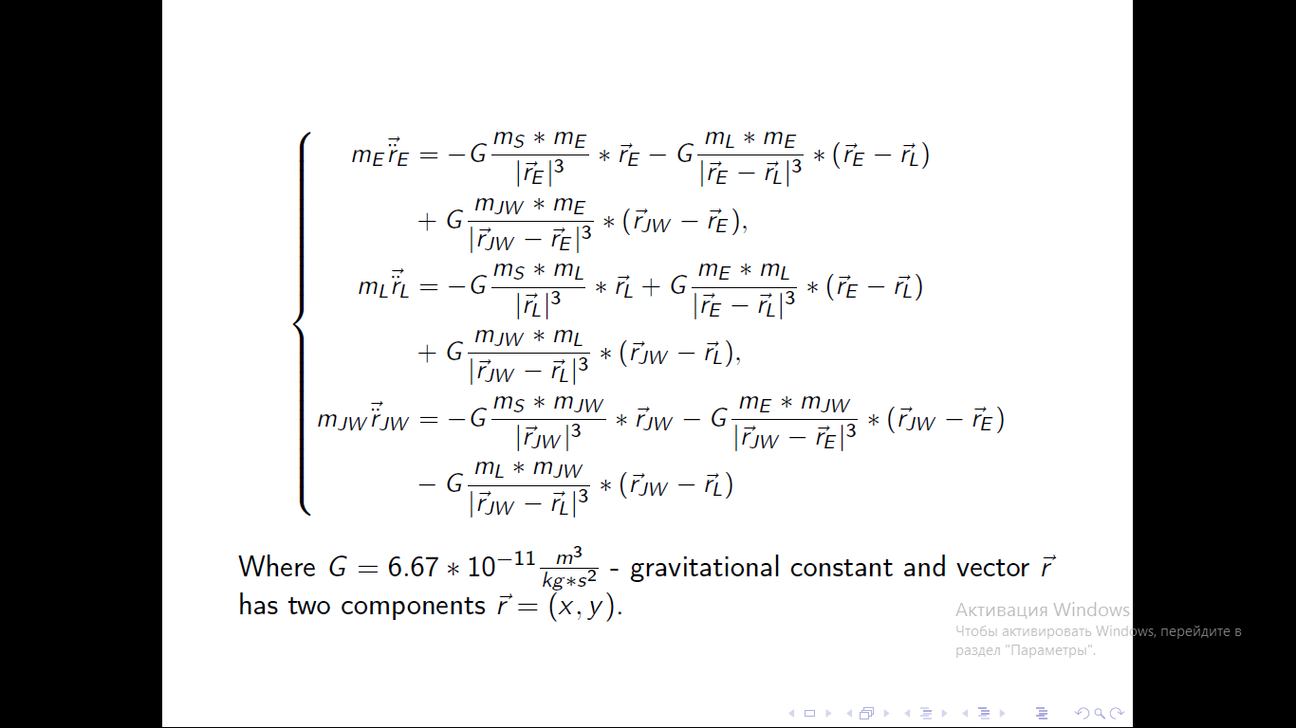

Slide 4
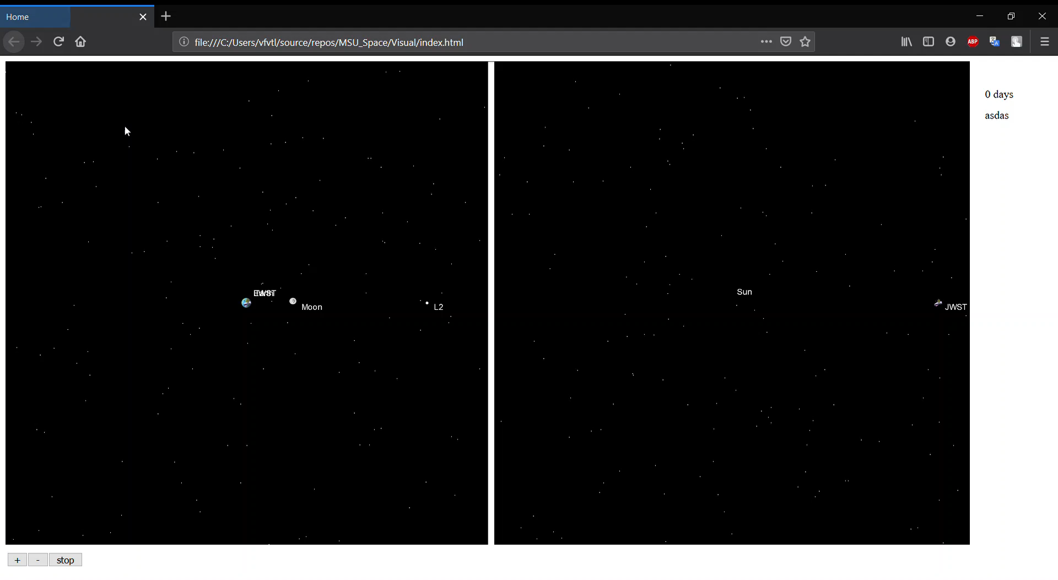

Slide 5
Future Development
1. We want to give freedom for user’s imagination!
2. More planets and objects in Solar system! 3. We are going to take into account relativistic effects and radiation of the Sun!
4. We want to develop our game/simulation and make it three dimensional (3D)!
5. We will add encyclopedia for users!

